Slide 1
AASD4011: Mathematical Concepts for Deep Learning
Applications of Deep Learning for Textual Data

Slide 2
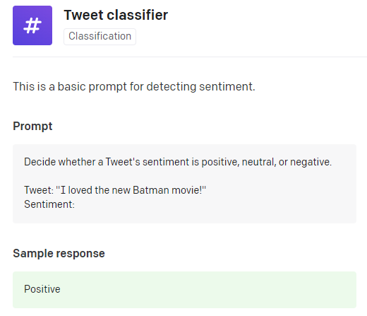
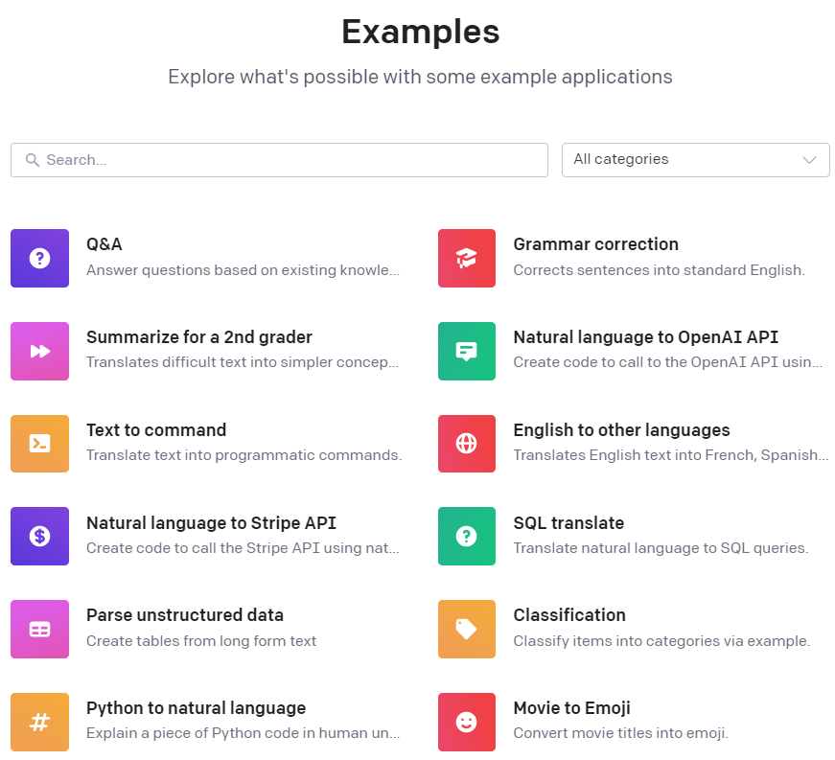
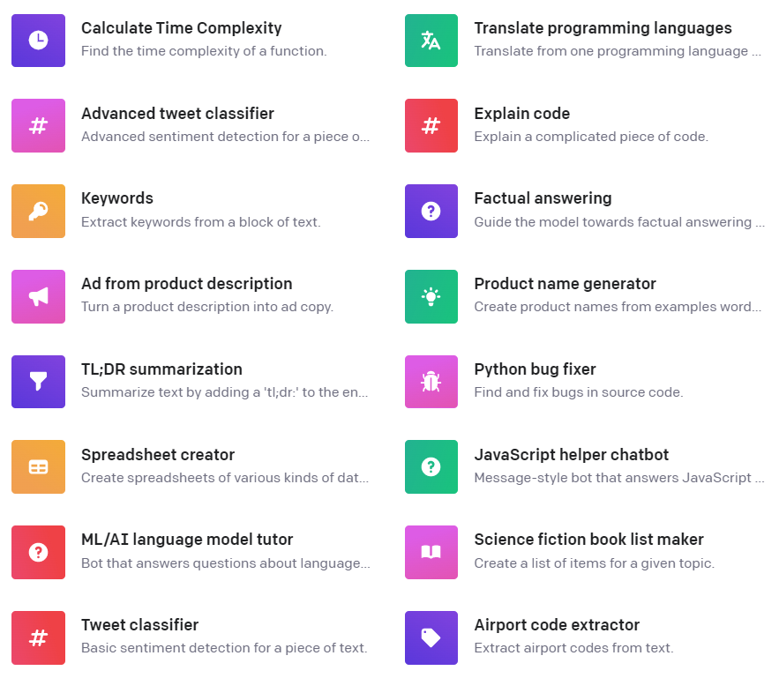
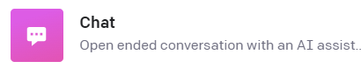
Applications of Deep Learning for Textual Data
These examples (and screen captures) were taken from OpenAI’s public API docs, on December 2022

Slide 3
Applications of Deep Learning for Textual Data
🤭💡
These examples (and screen captures) were taken from OpenAI’s public API docs, on December 2022

Slide 4
Applications of Deep Learning for Textual Data
These examples (and screen captures) were taken from OpenAI’s public API docs, on December 2022

Slide 5
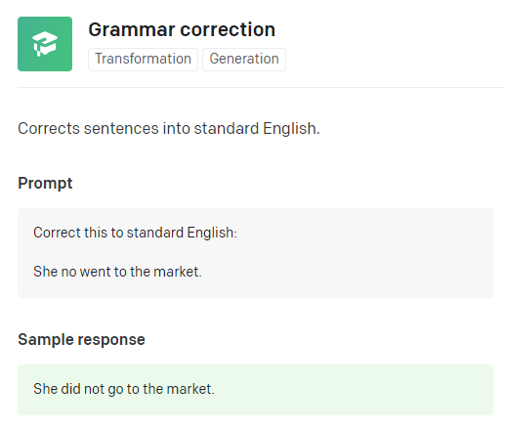
Applications of Deep Learning for Textual Data
These examples (and screen captures) were taken from OpenAI’s public API docs, on December 2022

Slide 6
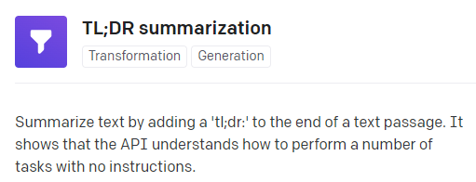
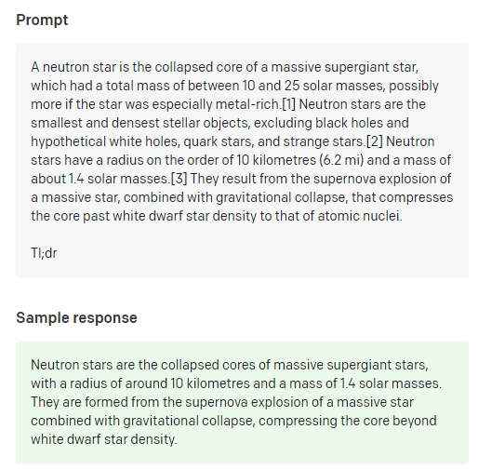
Applications of Deep Learning for Textual Data
These examples (and screen captures) were taken from OpenAI’s public API docs, on December 2022

Slide 7
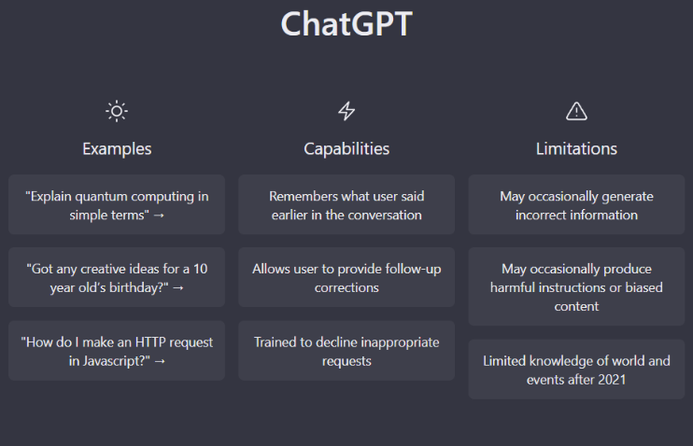
Applications of Deep Learning for Textual Data
These examples (and screen captures) were taken from OpenAI’s public API docs, on December 2022

Slide 8
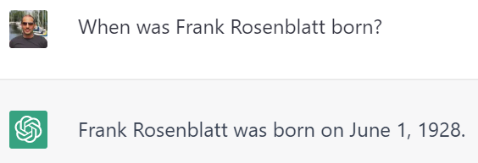
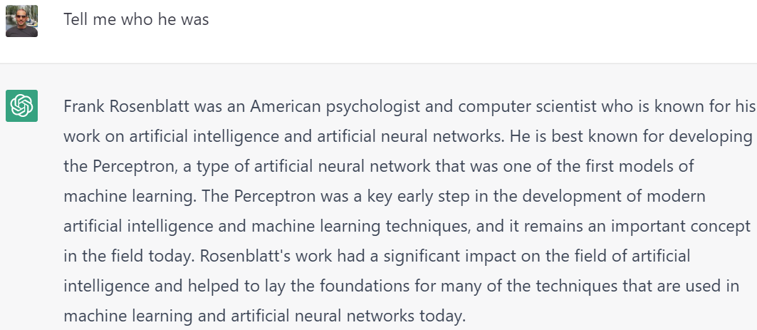
Applications of Deep Learning for Textual Data
Human:
ChatGPT:
Human:
ChatGPT:
These examples (and screen captures) were taken from OpenAI’s public API docs, on December 2022

Slide 9
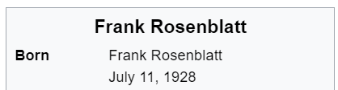
Applications of Deep Learning for Textual Data
Human:
ChatGPT:
Wikipedia
Human:
ChatGPT:
These examples (and screen captures) were taken from OpenAI’s public API docs, on December 2022

Slide 10

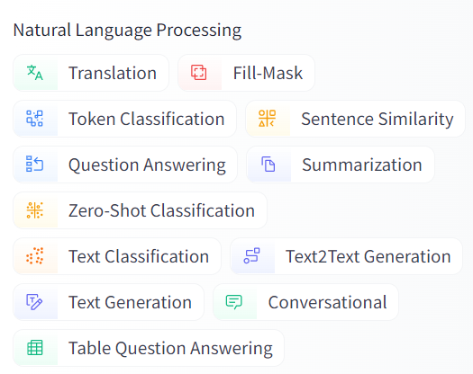
Applications of Deep Learning for Textual Data
These examples (and screen captures) were taken from HuggingFace Homepage, on December 2022

Slide 11
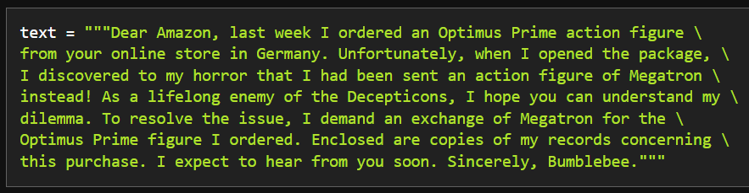
Applications of Deep Learning for Textual Data
The Transformers Book Repository, Introduction Notebook, Retreived December 2022

Slide 12
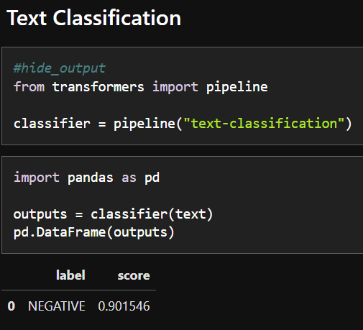
Applications of Deep Learning for Textual Data
The Transformers Book Repository, Introduction Notebook, Retreived December 2022

Slide 13
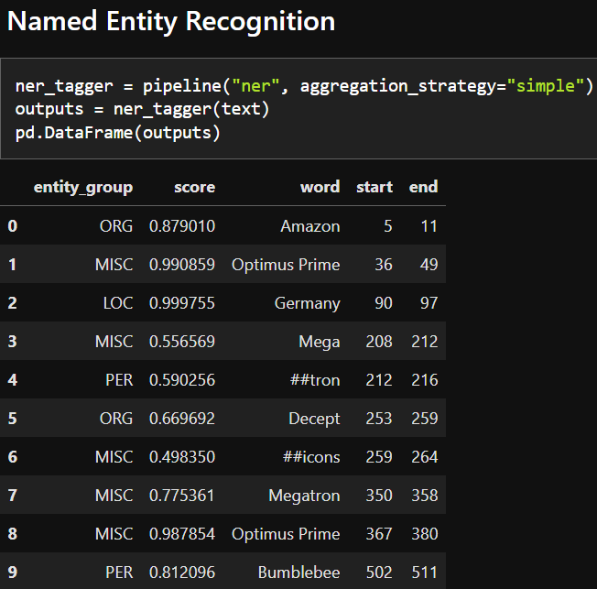
Applications of Deep Learning for Textual Data
The Transformers Book Repository, Introduction Notebook, Retreived December 2022

Slide 14
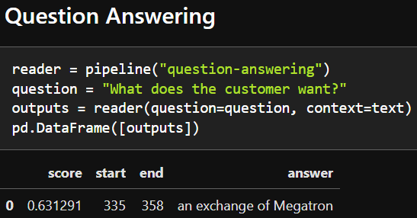
Applications of Deep Learning for Textual Data
The Transformers Book Repository, Introduction Notebook, Retreived December 2022

Slide 15
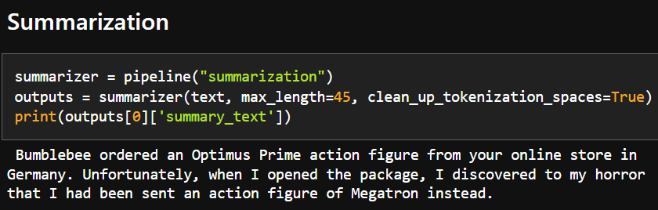
Applications of Deep Learning for Textual Data
The Transformers Book Repository, Introduction Notebook, Retreived December 2022

Slide 16
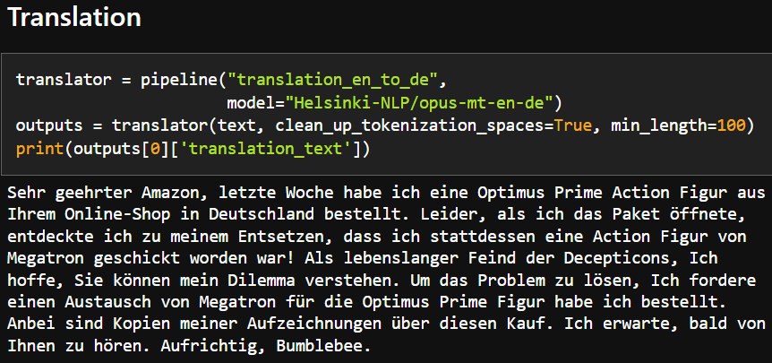
Applications of Deep Learning for Textual Data
The Transformers Book Repository, Introduction Notebook, Retreived December 2022

Slide 17
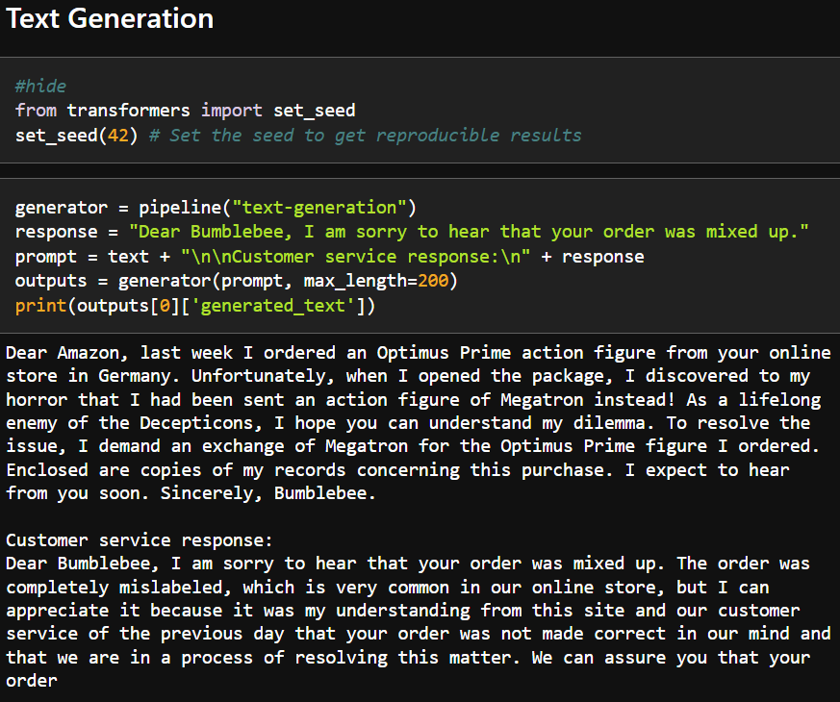
Applications of Deep Learning for Textual Data
The Transformers Book Repository, Introduction Notebook, Retreived December 2022

Slide 18

Note about the Resources
Privately-owned Models | Open-Source Models
API Access (for a fee) | Free Model Download
- | Educational Content (webpages, courses, book)
- | Hosting and API Service (for a fee)
As of December 2022

